Slide 1


ENGLISH LEVEL B1 - II
Lesson 02
PREPARING FOOD AND COOKING

Slide 2

01
Learning about ingredients and cooking
02
Use modal verbs when speaking
ENGLISH LEVEL B1 - II

Slide 3
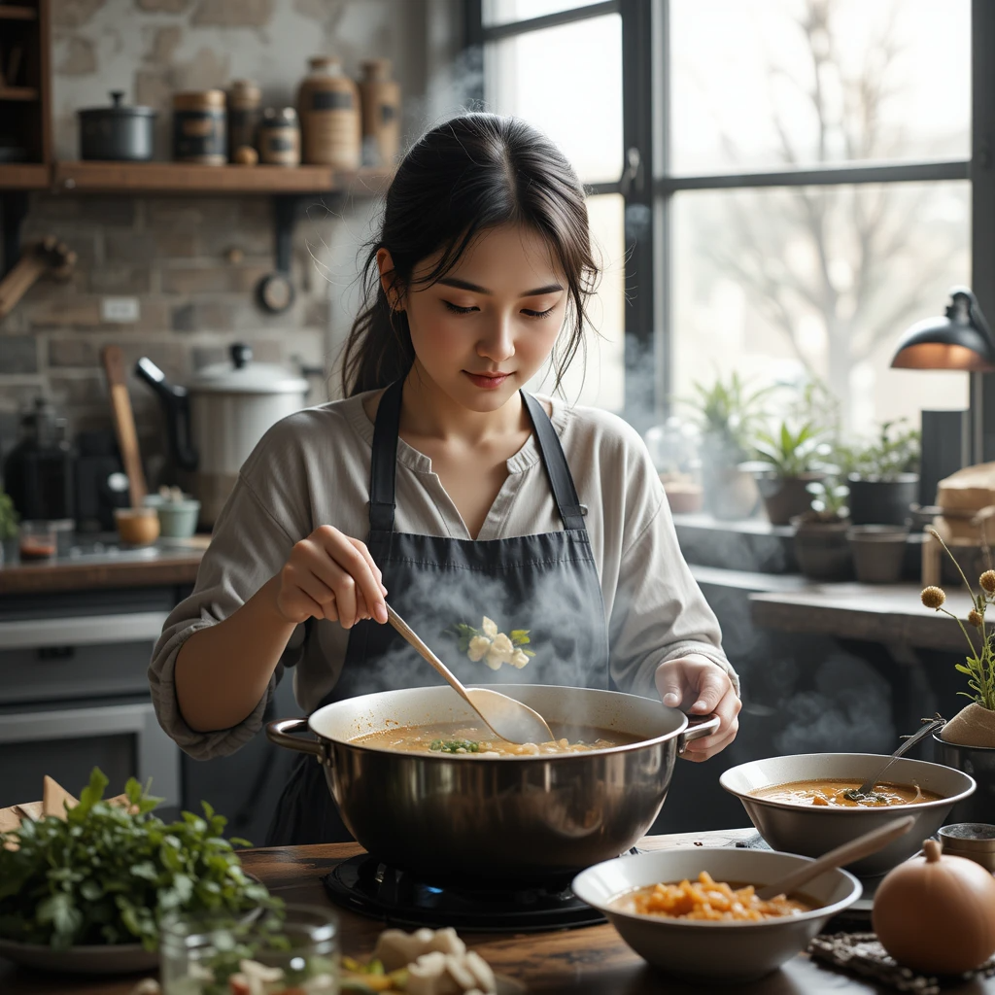
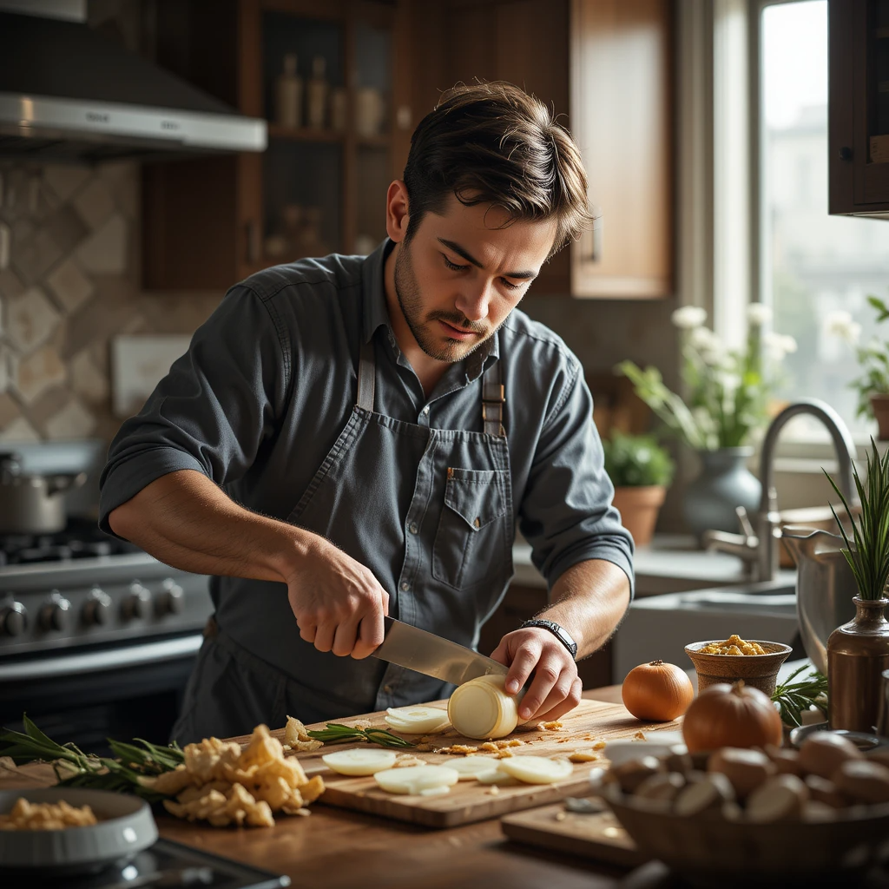
PREPARING FOOD
PREPARING FOOD CONTEXT Look at the pictures about “Preparing Food and Cooking” and answer the questions below.
1
What is happening in each situation?
2
What ingredients or tools are being used?
3
What type of meals do you think are making?
4
How do you think this dishes will be prepared?
Notes:
Teacher notes:
Ask students to look at the image and comment on what they see in it.
Kindly correct them if necessary.

Slide 4
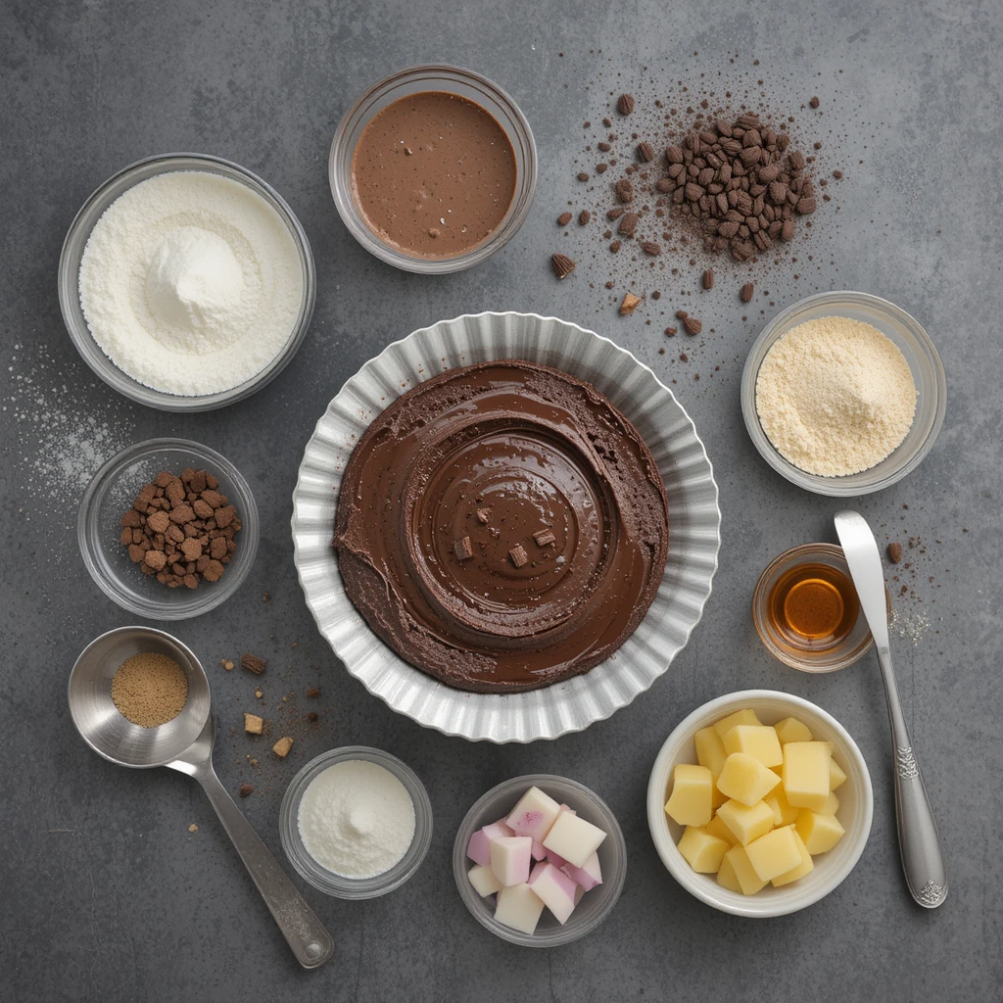
PREPARING FOOD
Preparing food Context
Look at the picture and answer the questions below.
What ingredients can you see?
What can you make with these ingredients?
What is the first step to prepare this meal?
Have you ever cooked something similar?
Notes:
Teacher notes:
Ask students to look at the image and comment on what they see in it.
Kindly correct them if necessary.

Slide 5
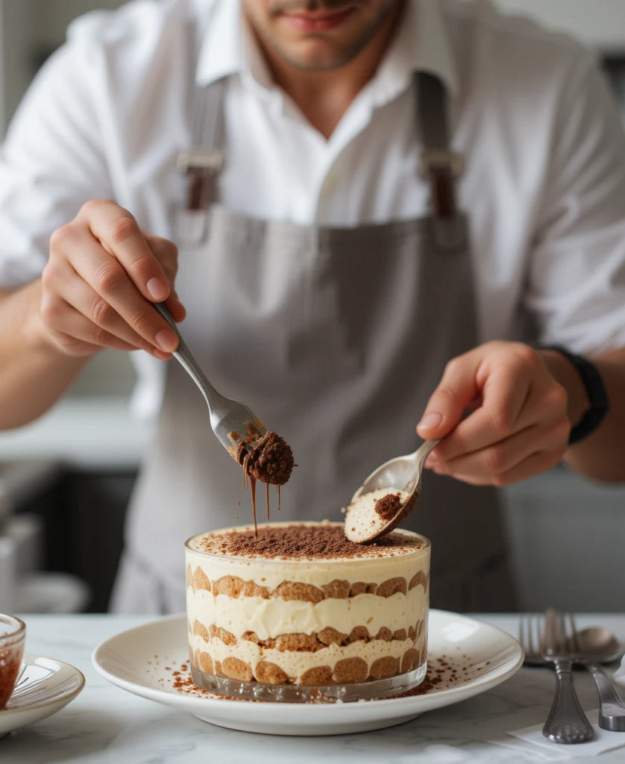

PREPARING FOOD
Listen to the conversation about cooking and answer the questions below:
What ingredients do you need to make tiramisu?
Why is adding liquor optional in the tiramisu recipe?
What is the most delicate step in making tiramisu, and why is it important?
Why is it necessary to chill the tiramisu before serving?

Slide 6
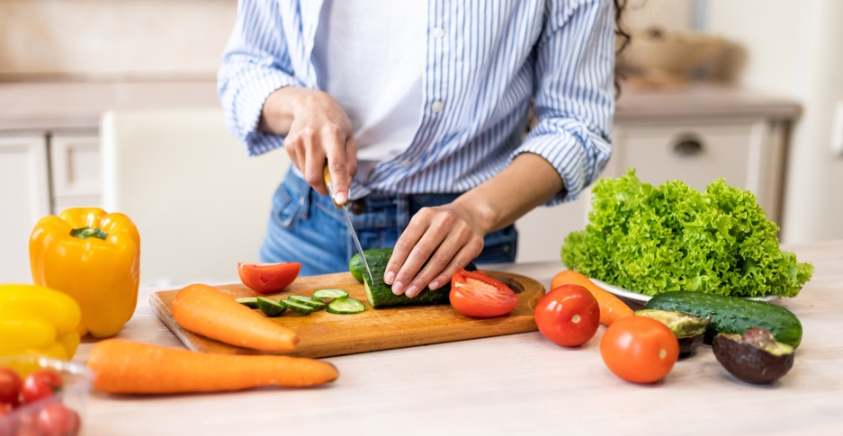
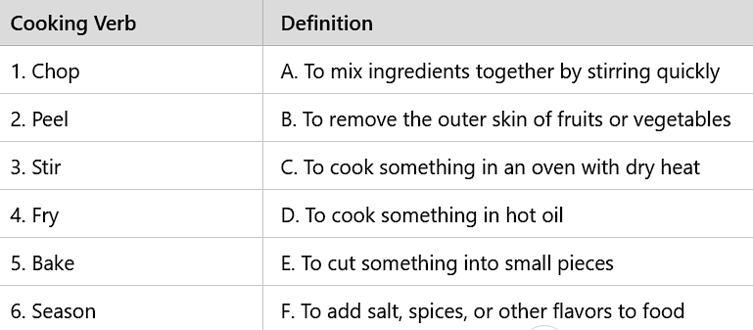
PREPARING FOOD
DAYS OF THE WEEK
Vocabulary:
Activity:
Common Words and Phrases:
Actions: Chop, slice, peel, boil, fry, bake, grill, stir, mix, season.
Ingredients: Salt, pepper, garlic, onion, olive oil, flour, butter.
Match the cooking verbs with their correct definitions.

Slide 7
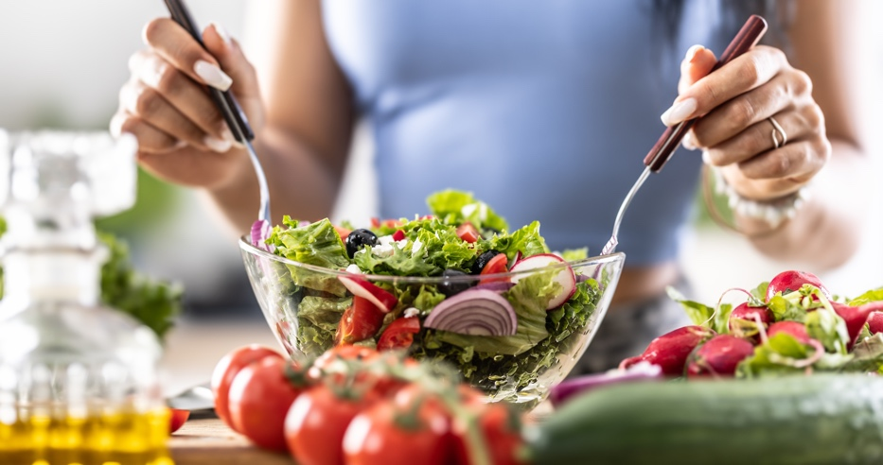
Modal Verbs
Activity:
May/Might → Express possibility (e.g., I might add more salt.)
Can/Could → Express ability (e.g., I can chop the vegetables.)
Should/Shouldn't → Give advice (e.g., You should let the soup simmer for 10 minutes.)
Complete the Sentences with the Correct Modal Verb
You ______ chop the vegetables before boiling them.
I ______ add more sugar if the mixture is too bitter.
He ______ cook really well; his pasta is amazing!
You ______ eat too much fried food; it’s unhealthy.
We ______ forget to preheat the oven before baking the cake.
She ______ need some extra time to prepare the dough.
______ you help me whisk the eggs?
When I was younger, I ______ not cook at all, but now I can.

Slide 8
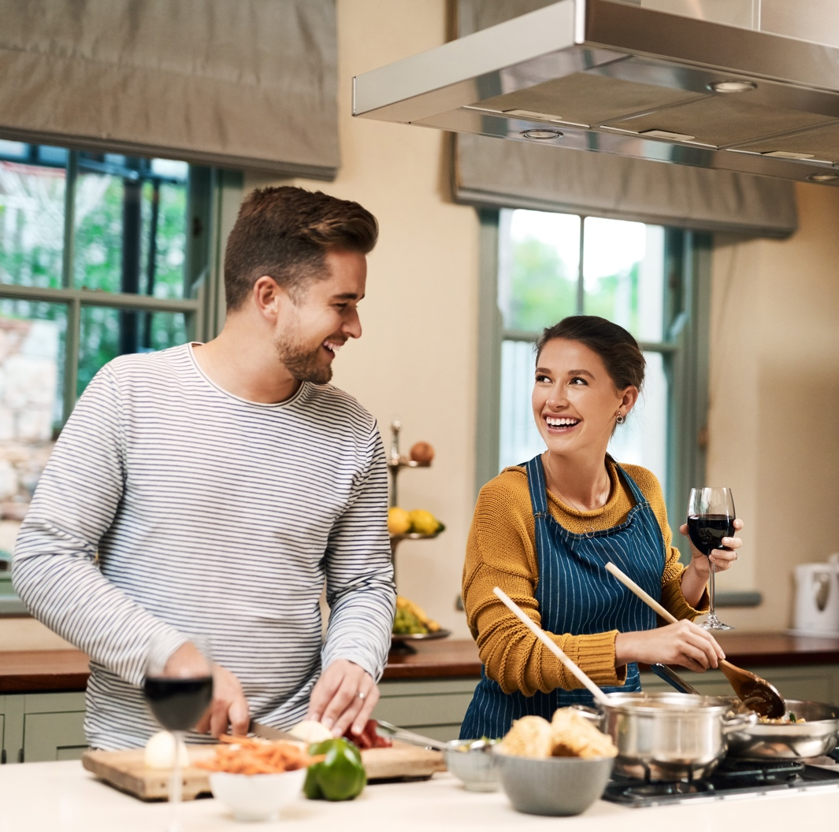
Activity:
Work in pairs or groups: Choose a recipe.
Discuss the steps and ingredients needed.
Use modal verbs to give advice on how to improve it.
Present your recipe to the class.

Slide 9
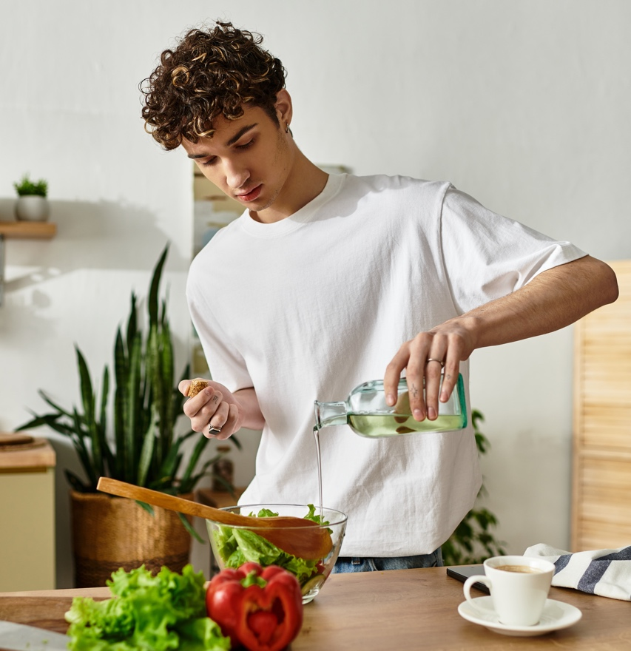

GOING TO THE RESTAURANT
CLASS DISCUSSION: REFLECT AND APPLY
What new words did you learn?
Give an example using a modal verb.
Describe how to prepare a simple dish.

